Slide 1
POWER BI • DATA ANALYTICS
Global Population
Dashboard
Population Trends • Continental Shifts • Density Analysis • Future Projections
Presented by
Jerry James
1970 – 2025

Slide 2
AGENDA
01
04
Project Overview
5 Analytical Questions
Objective, dataset, and key questions addressed
Charts, insights, and visualizations
02
05
Dataset Information
Dashboard & KPIs
Source, fields, and coverage details
Key performance metrics and final dashboard
03
06
Tools & Preparation
Conclusion
Power BI, Power Query, DAX Calculations
Key takeaways from the analysis

Slide 3
PROJECT OVERVIEW
What Is This Project?
This dashboard analyzes population trends across countries and continents from 1970 to 2025, delivering key demographic insights through interactive Power BI visuals.
📊
🌍
🔮
Analyze Growth
Map Density
Project Future
Track country-level and continental population change over 55 years
Identify high-density nations and the pressures they face
Forecast which nations will drive global population by 2025

Slide 4
DATASET INFORMATION
📁 Source: Kaggle World Population Dataset
Country
Nation-level records for all continents
Continent
Grouped by 6 global regions
Population Data
Year-wise figures from 1970 to 2025
Growth Rate
Annual % increase per country
Density
Population per km² land area

Slide 5
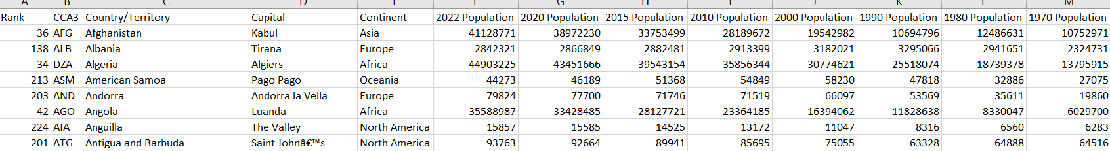

Slide 6
TOOLS USED
⚡
Power BI
📦
Kaggle Dataset
Interactive dashboard creation and data visualization platform
Source of structured World Population data used for analysis
🔧
Power Query
🧮
DAX Calculations
ETL tool for data transformation, cleaning, and shaping
Data Analysis Expressions for custom KPIs and metrics

Slide 7
DATA PREPARATION
01
Data Import
Loaded Kaggle World Population dataset into Power BI via Power Query connector
02
Data Cleaning
Fixed data types, standardized country and continent names
03
Transformation
Unpivoted year columns into rows; created calculated columns for growth metrics
04
DAX Measures
Built custom KPIs: Total Population, Growth Rate %, Density per km², YoY Change
05
Dashboard Design
Structured 3 report pages with slicers, filters, charts, and KPI cards

Slide 8
QUESTION 1 OF 5
Q1
Which countries experienced the highest population growth from 1970 to 2025?
Visualization: Bar Chart

Slide 9
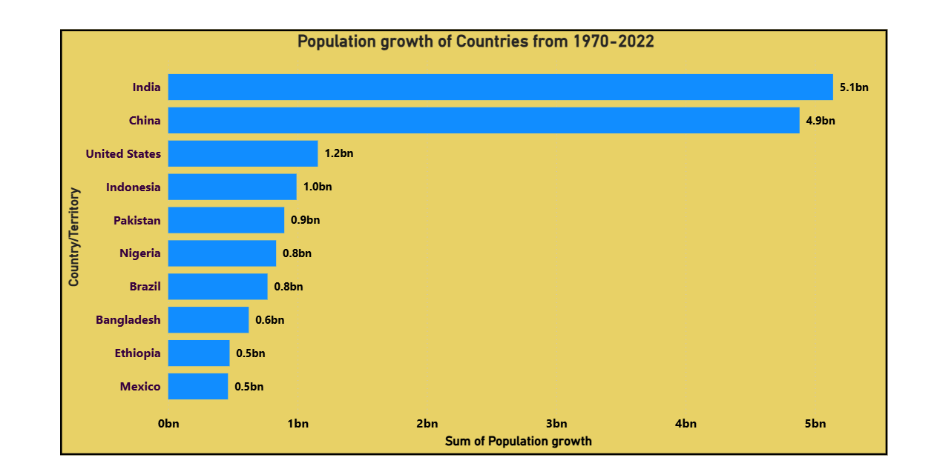
Q1 INSIGHTS — POPULATION GROWTH BY COUNTRY
Key Insights
India & China recorded the largest absolute population gains over 52 years
Developing nations contributed the majority of global growth
Rapid expansion strains food, water & infrastructure resources

Slide 10
QUESTION 2 OF 5
Q2
How does population distribution vary across continents over the years?
Visualization: Stacked Area Chart

Slide 11
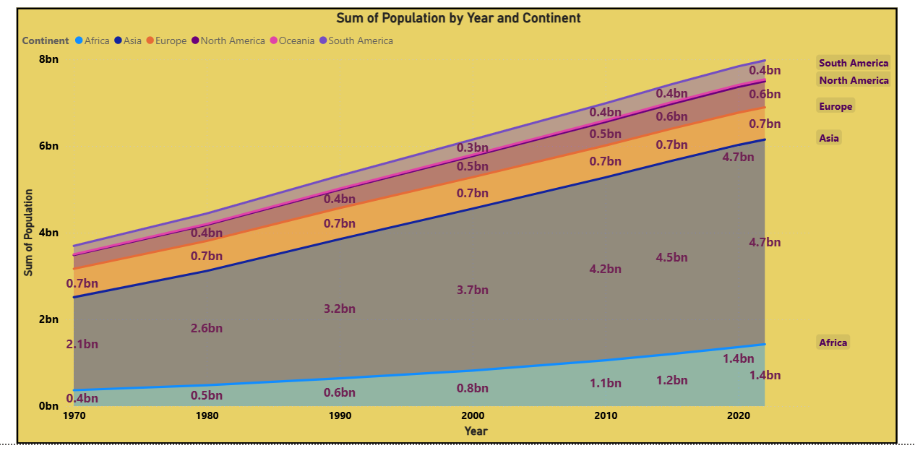
Q2 INSIGHTS — POPULATION DISTRIBUTION BY CONTINENT
Key Insights
Asia dominates, holding over 60% of the world's population
Africa shows the fastest upward growth trajectory
Europe's growth is the slowest among all continents

Slide 12
QUESTION 3 OF 5
Q3
Which countries have high population density despite smaller land area?
Visualization: Scatter Plot

Slide 13
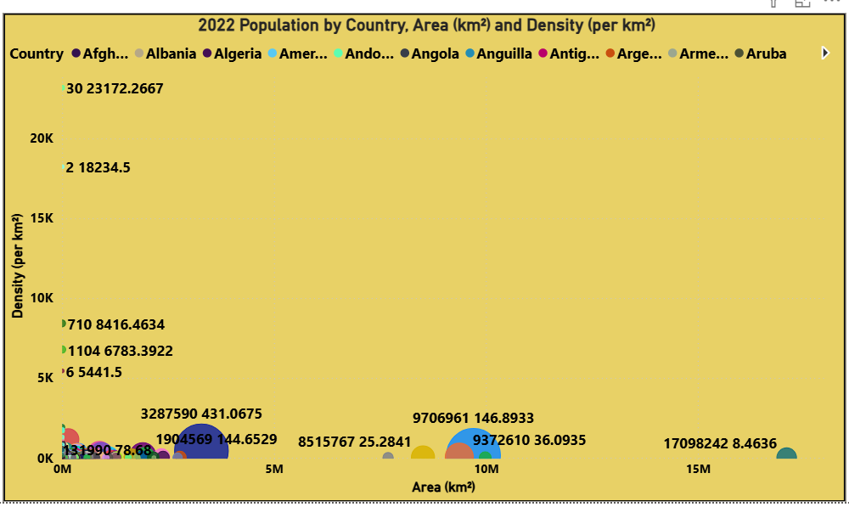
Q3 INSIGHTS — POPULATION DENSITY VS. LAND AREA
Key Insights
Bangladesh & Singapore have extreme density relative to land size
High density intensifies urban pressure and housing challenges
Resource and infrastructure management becomes critically important

Slide 14
QUESTION 4 OF 5
Q4
Which countries are likely to contribute most to future population growth by 2025?
Visualization: Treemap

Slide 15
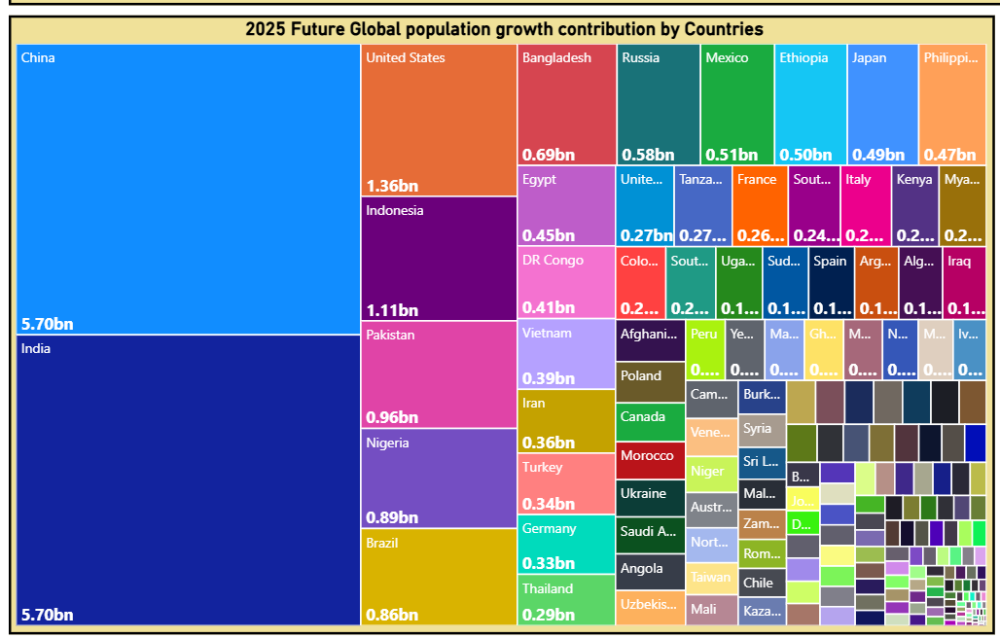
Q4 INSIGHTS — FUTURE POPULATION GROWTH DRIVERS
Key Insights
India surpasses China as the world's most populous nation
Nigeria & Pakistan are among the fastest-growing large countries
Sub-Saharan Africa will drive the majority of 21st-century growth

Slide 16
QUESTION 5 OF 5
Q5
What are the trends in population growth between developed and developing countries?
Visualization: Line Chart

Slide 17
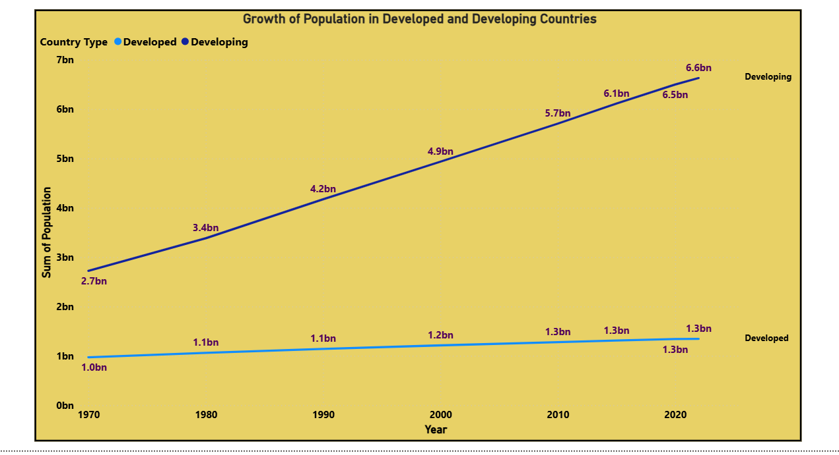
Q5 INSIGHTS — DEVELOPED VS. DEVELOPING GROWTH TRENDS
Key Insights
Developing countries grow significantly faster than developed ones
Developed nations show near-flat population curves post-2000
Economic development strongly correlates with declining fertility

Slide 18
DASHBOARD KPIs
🌍
📅
🗺️
🧭
📈
8.1B
1970
195+
6
55 Yrs
World Population
2025
Data Start
Year
Countries
Covered
Continents
Analyzed
Time Span
Covered
What the Numbers Tell Us
8.1B global population confirms unparalleled scale of human growth by 2025
195+ countries provide a truly comprehensive demographic picture
55-year span captures two full generations of demographic transformation

Slide 19
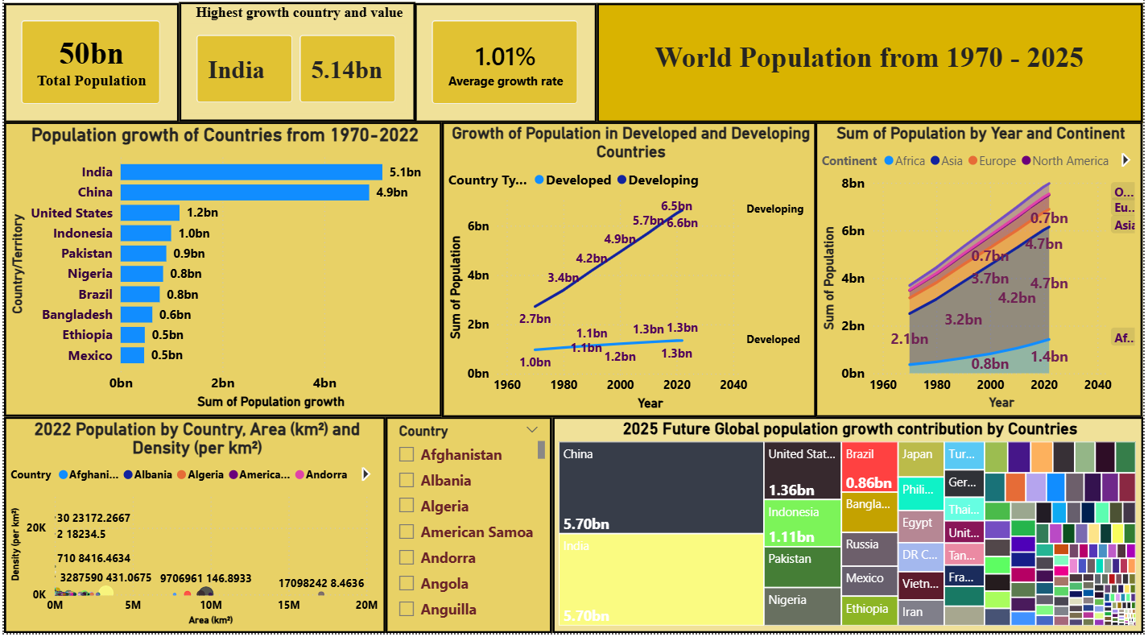
DASHBOARD OVERVIEW
Total Population: 8.1B
Growth Rate: 1.1%
Highest Growth: India
Densest: Bangladesh
📊 Population Growth Bar Chart
[Power BI Visual Placeholder]
🌍 Continental Area Chart
📡 Density Scatter Plot

Slide 20
CONCLUSION
Key Takeaways
🌍
📈
Global Trends Identified
Asia & Africa Lead Growth
The dashboard successfully highlights demographic trends, growth patterns, and regional shifts from 1970 to 2025.
Asia dominates in absolute numbers while Africa shows the fastest growth trajectory, shaping the future population landscape.
🏙️
🔮
Density & Urban Pressure
Future Projections Clear
Nations like Bangladesh and Singapore face critical urban and resource challenges due to extreme population density.
India , China, Nigeria, and Pakistan will drive future global population growth, making them key focus areas for policy and planning.

Slide 21
THANK YOU
Global Population Dashboard | 1970–2025
Data Source: Kaggle World Population Dataset | Tools: Power BI, Power Query, DAX

